Slide 1




2022 Annual General Assembly of Members
March 19, 2022

Slide 2

The Responsible and Empowered Mindoreños Credit Cooperative was organized in 2018, under the inspiration and consent of Bp. Warlito I Cajandig through the leadership of Fr. Jimson H. Ruga, Ph.D. REMICCO is a membership based organization duly registered with Cooperative Development Authority on April 25, 2018. REMICCO is a partner of SFI and Apostolic Vicariate of Calapan.

Slide 3

REMICCO aspires to be a service oriented credit cooperative in Mindoro Province contributing to the progress and empowerment of our members and socially responsible to the community.

Slide 4

Inspired by Christian values, REMICCO commits to provide innovative financial and personal development that will undertake socio-economic activities relevant to the members’ felt need in an efficient, friendly and professional manner.

Slide 5

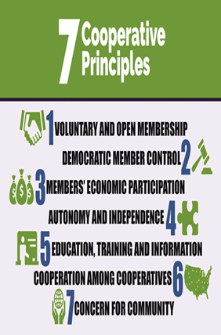
The ultimate goal of REMICCO is to help enrich the quality of life of Mindoreños through an excellent and caring services embedded on Christian values. Towards this end, the cooperative endeavors to achieve an d follow the (7)Seven Cooperative Principle.

Slide 6

Excellent and caring service
Good governance
Discipline
Competence

Slide 7

REMICCO is dedicated in contributing to the progress and empowerment of its members. It always continues to find ways to serve its clientele better.
Despite of all the economic disruption being faced by many organizations, due economic instability, REMICCO were still able to operate and continue to deliver financial and services to the members it serve.

Slide 8

The Patron Saint of REMICCO is Saint Mark the Evangelist. The symbol of St. Mark is a Winged Lion. The Lion with wings symbolizes courage, strength, and freedom. It is a representation of the power of the soul and its ability to break away from earthly confines to soar through the heavens.
Courage: A lion with wings symbolizes the strength of character and courage to overcome fear and stand up for one’s convictions.
Strength: It personifies the inner strength necessary to push through insurmountable obstacles and remain unbowed in the face of adversity.
Freedom: A lion with wings symbolizes the freedom of the spirit, allowing it to move freely and explore uncharted paths.
Power: It expresses the powerful energy of the soul, which is capable of achieving great things

Slide 9
Driving Sustainable Growth: Financial and Social Development 2025

Slide 10
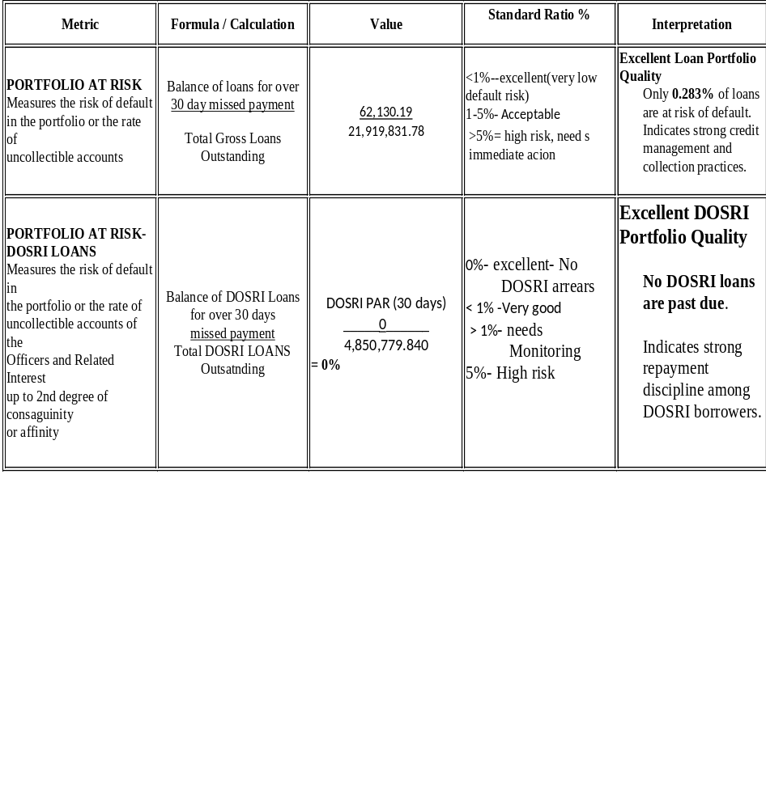
Portfolio Quality

Slide 11
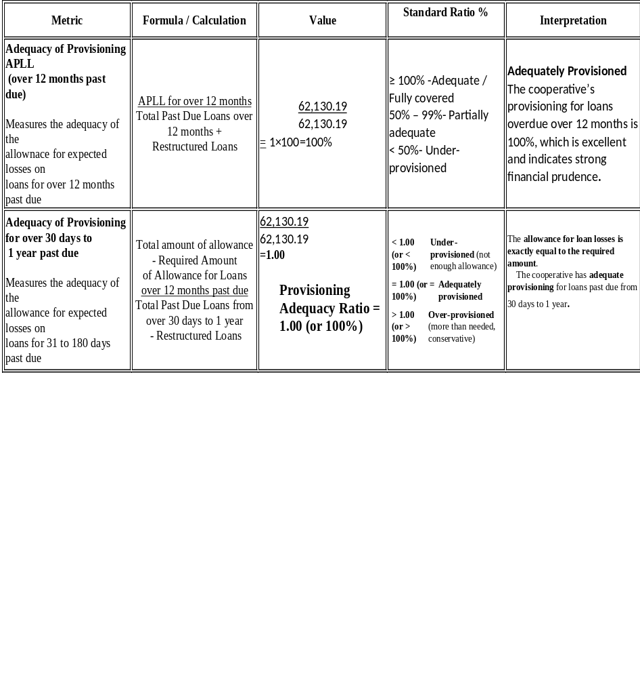
Portfolio Quality

Slide 12
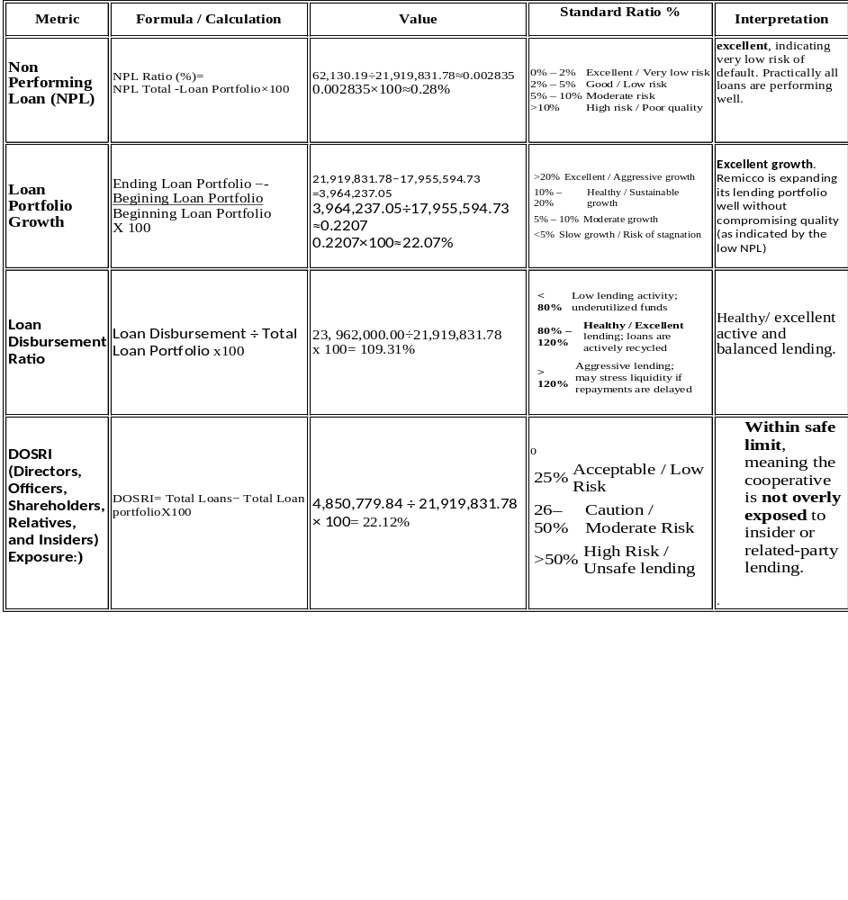
Portfolio Quality

Slide 13
PORTFOLIO QUALITY
For the year 2025, Remicco demonstrated excellent portfolio quality, reflecting strong credit management, active lending operations, and prudent risk control. The key performance indicators are summarized below:
Loan Portfolio Growth
Remicco’s loan portfolio increased from ₱17,955,594.73 in 2024 to ₱21,919,831.78 in 2025, representing a growth rate of 22.1%. This growth exceeds the typical benchmark for cooperatives (>20%) and indicates a robust expansion of lending operations while maintaining prudent risk management.
Loan Disbursement Ratio
The cooperative disbursed ₱23,962,000 in loans during the year, resulting in a loan disbursement ratio of 109.36%. This ratio falls within the excellent range (80–120%), demonstrating an active lending cycle where loans are being efficiently released and repaid, contributing to strong portfolio turnover.
Non-Performing Loans (NPL) Ratio
With non-performing loans of only ₱62,130.19, the NPL ratio stands at 0.28%. This is well below the standard threshold of 2% for excellent portfolio quality, reflecting very low credit risk and the effectiveness of Remicco’s credit evaluation and monitoring practices.
DOSRI Exposure
Loans to Directors, Officers, Shareholders, Relatives, and Insiders (DOSRI) totaled ₱4,850,779.84, representing 22.13% of the total loan portfolio. This is within the recommended maximum limit of 25%, ensuring that insider lending does not compromise cooperative safety and governance.

Slide 14
Indicators and Target for Portfolio Quality 2026
Indicator | 2025 Actual | Standard / Benchmark | 2026 Target
Loan Portfolio Growth | 22.1% | >20% → Excellent | 20–25% growth ₱26.3M – ₱27.4M total portfolio
Loan Disbursement Ratio | 109.36% | 80–120% → Excellent | 100–120% ₱26.3M – ₱31.6M disbursed
Non-Performing Loans (NPL) Ratio | 0.28% | 0–2% → Excellent | ≤0.5% keep NPL below ₱131,500
DOSRI Ratio | 22.13% | ≤25% → Safe | ≤25% ₱6.57M; 20% -₱5.26M

Slide 15
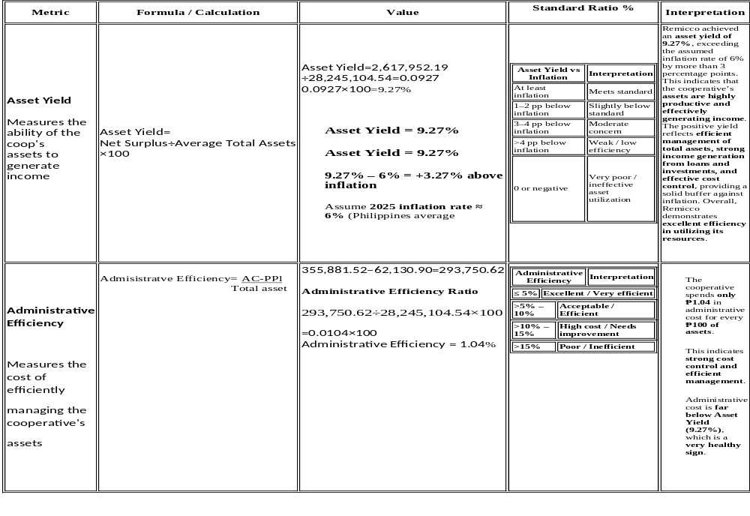
Efficiency

Slide 16
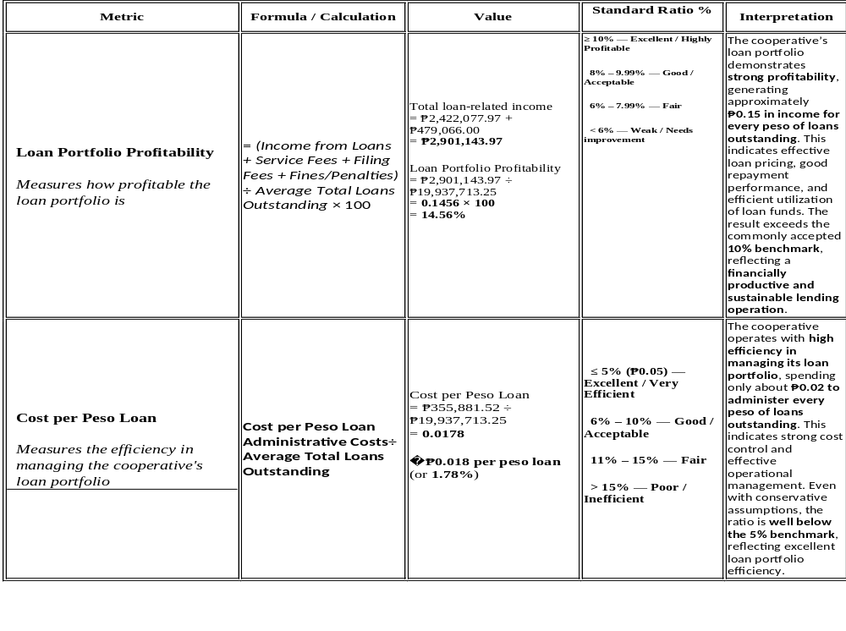
Efficiency

Slide 17
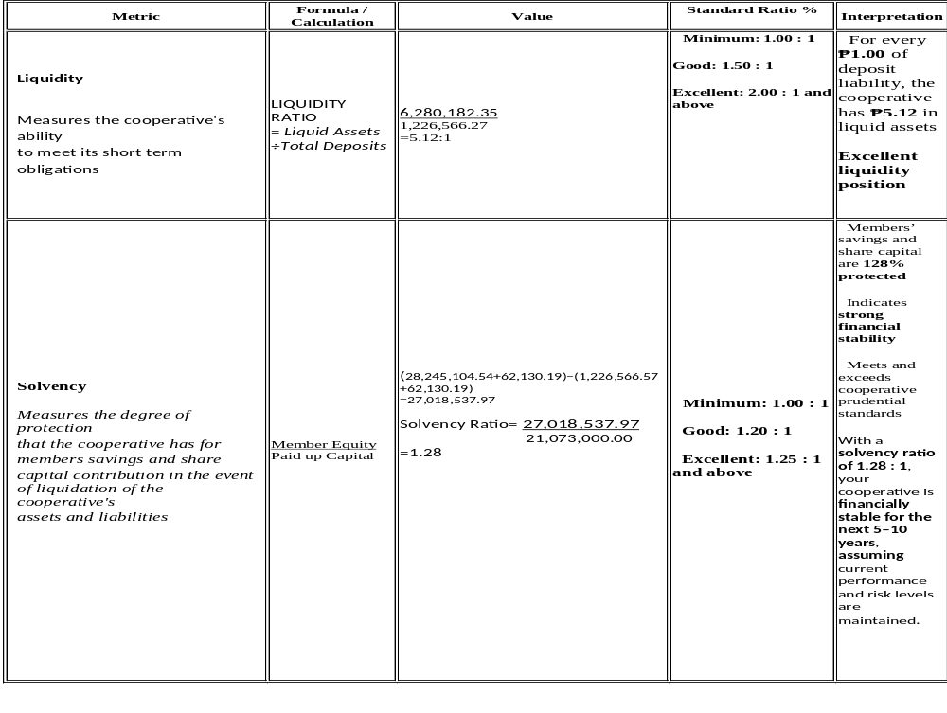
STABILITY

Slide 18
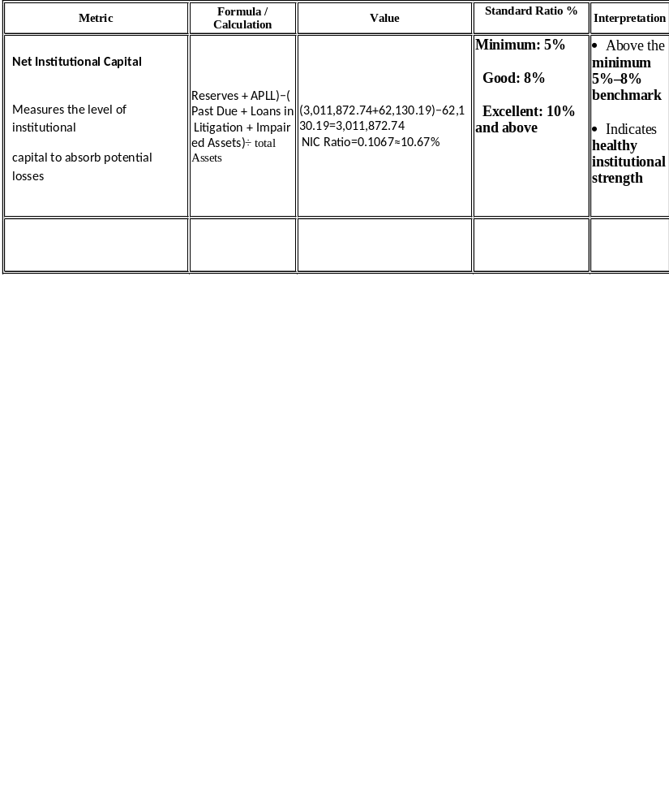
STABILITY
Stability Assessment
Remicco shows:
Very strong liquidity
High solvency and member protection
Adequate institutional capital to absorb risk
This is a financially sound and well-managed cooperative

Slide 19
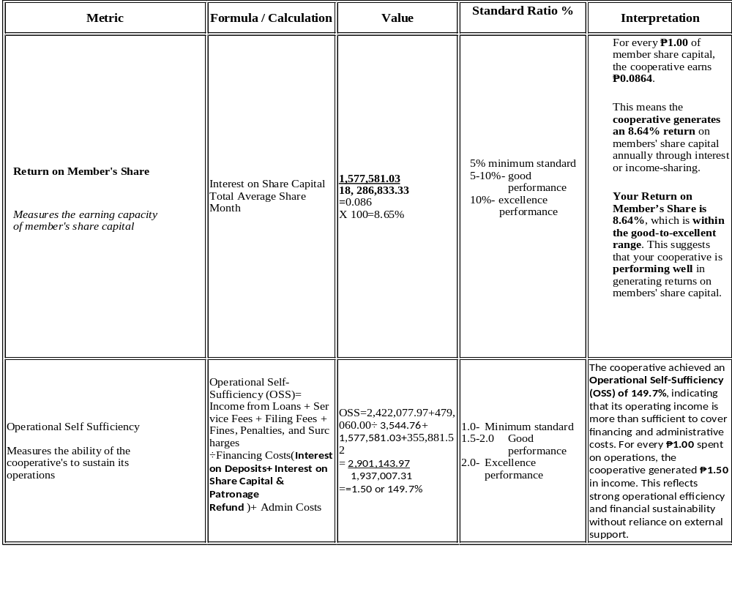
OPERATION

Slide 20
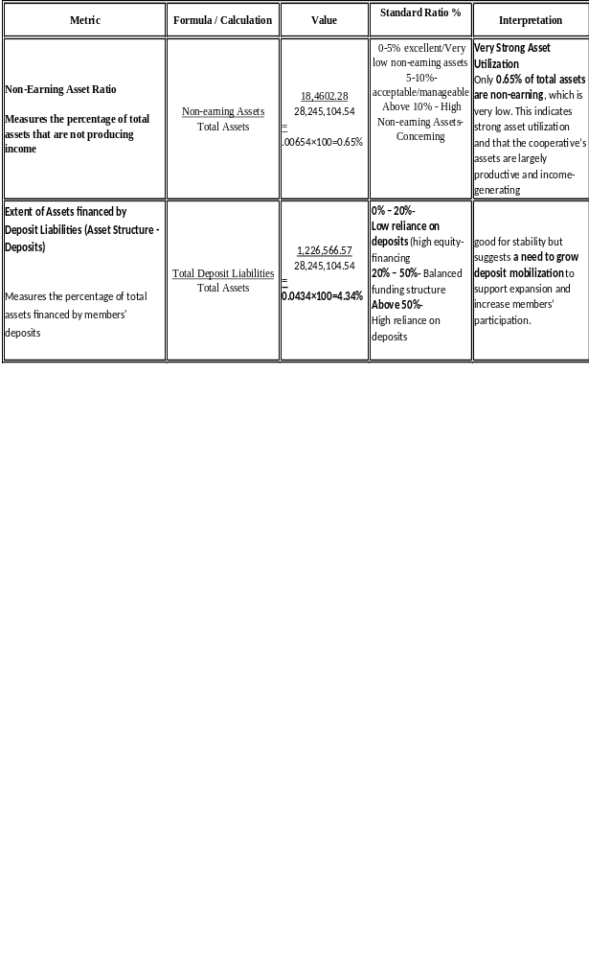
STRUCTURE OF ASSETS

Slide 21
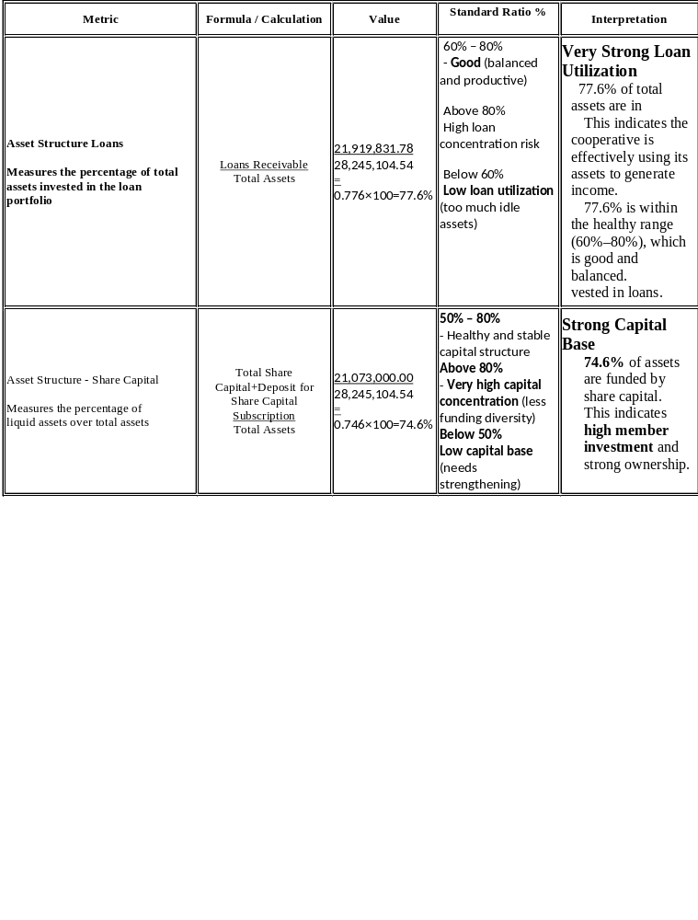
STRUCTURE OF ASSETS

Slide 22
Performance Overview 2024–2025

Slide 23
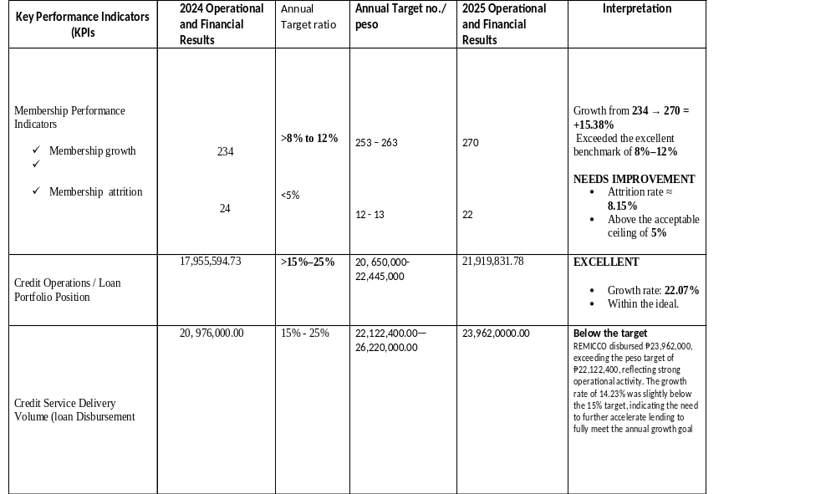

Slide 24
Key Performance Indicators (KPIs | 2024 Operational and Financial Results | Annual Target ratio | Annual Target no./ peso | 2025 Operational and Financial Results | Interpretation
Financial Position – Asset Base ( Total Asset) | 23,031,837.95 | >12% | 25,800,000.00 | 28,245.104.54 | EXCELLENT Asset growth ≈ 22.6% Far exceeded target
Operating Income ( gross income | 2,390,715.96 | >15% | 2,749,323.35 | 2,937,833.71 | EXCELLENT Growth ≈ 22.9% Income growth outpaced asset growth (efficient utilization)
Net Operating Surplus ( net surplus | 2,103,441.37 | >12% | 2,400,000.00 | 2,617,952.19 | EXCELLENT Growth ≈ 24.5% Strong cost control and income generation
Capital & Equity Position (Member Equity) | 21,235,824.08 | >12% | 23,800,000.00 | 27,018,537.97 | EXCELLENT Growth ≈ 27.4% Equity-to-asset ratio ≈ 95.66%

Slide 25
Key Performance Indicators (KPIs | 2024 Operational and Financial Results | Annual Target ratio | Annual Target no./ peso | 2025 Operational and Financial Results | Interpretation
Member Share Capital | 16,211,000.00 | >10% | 18,000.000.00 | 21,073,000.00 | EXCELLENT Growth ≈ 30% Indicates high member confidence and participation
Financial Obligations | 1,766,018.87 | <30% | 1,240,000.0a0 | 1,226,566.57 | EXCELLENT Liabilities ≈ 4.34% of total assets Well below risk threshold
Statutory & General Reserves | 2, 589,733.38 | 10% | 2,850,000.00 | 3,0a11,672.74 | EXCELLENT Reserve fund ≈ 10.7% of assets Fully compliant with statutory standards
Portfolio Quality Indicator (NPL)Non-performing Loan | 0 | <1% |  | 62,130.19 | EXCELLENT Very strong loan quality Minimal credit risk

Slide 26
SOCIAL DEVELOPMENT PROGRAM
The social development program of the cooperative focuses on two (2) areas: a) for the cooperative itself; and b) for the community. The source of fund for the first area may vary from Cooperative Education and Training Fund (CETF), optional fund or outright expense; while the second area is exclusive from the Community Development Fund (CDF).

Slide 27
KEY AREAS | SPECIFIC ACTIVITIES | NO. OF ACTIVITIES | NO. OF BENEFICIARIES |  |  | AMOUNT UTILIZED | SOURCE OF FUND
 |  |  | MALE | FEMALE | TOTAL
Health program | Participate in CCDC MEDICAL MISSION Activity for coop month celebration | 1 | 1 |  | 1 | - | CDF
Social events/gatherings | 8th Anniversary Celebration | 1 |  |  | 1 | 11,000.00 | CETF
Social protection (insurance and mutual benefits) | Burial Assistance/ Mortuary Benefits |  |  |  |  |  | CBLIC
 | Funeral Wreath |  |  |  |  |  | CDF
 | Medical Assistance/ Hospitalization Benefits | 1 |  |  | 1 | 5,000 | CDF
total |  |  |  |  |  | 16,000.00

Slide 28
KEY AREAS | SPECIFIC ACTIVITIES | NO. OF ACTIVITIES | NO. OF BENEFICIARIES |  |  | AMOUNT UTILIZED | Source of fund
 |  |  | MALE | FEMALE | TOTAL
Environment conservation and protection | To Participate in NGO environmental protection program activity such as mangrove and tree planting | 1 | 9 | 5 | 14 | - | CDF Partner LGU/NGO
Health and sanitation | None | - | - | - | - | -
 | ATTENDED 3RD REGIONAL COOOP CONGRESS
 |  | 1 | - | 1 | 1 | 7,293.00 | CETF
 | Attended
 | CITY COOPERATIVE MONTH ACTIVITY
 |  | 1 |  |  | 1 | - | CETF
 | Joined Annual
Partnership and community groups | Ownership Meeting of Mifedco | 1 | 1 | - | 1 | - | CETF
 | Attend
 | Cooperative
 | Month Opening Program and Thanksgiving | 1 | 1 | - | 1 | - | CETF
 | Mass at Sto Niño Cathedral for coop month Celebration
Disaster Risk Reduction & Management Basic Life support | Participated in basic life support seminar | 1 | 1 | - | 1 | - | CETF

Slide 29
Gender equality and women empowerment | Conducted Free Gender and Development Orientation | - | - | - | - | - | CETF
Inclusivity (Membership expansion) | None | - | - | - | - | -
Educational Assistance Program | Giving Cash Assistance to individual in crisis situation | 1 | 32 | 68 | 100 | 5,766.50(CDF) 300,000(DSWD) | CDF/ Prtner NGO and DSWD
Support to the vulnerable sector of society | Donate learning Materials to Differently School during Oplan Balik eskwela 2025 | - | - | - | - | - | CDF Partner NGO
Children and Youth | Outreach activity; giving HYGIENE KIT TO BAHAY KANLUNGAN | 1 | - | - | - | 3.000.00 | CDF
Person with Disabilities | Cash Donation LINGAP CENTER | 1 | - | - | - | 5,000.00 | CDF
Elderly | Donated 3 sacks rice, s and assorted goods to the Aruga Kapatid Foundation | 1 | 5 | 8 | 13 | 10,172.84 | CDF
Outreach Program: Charity And Giving Program | Sharing blessing through Food Packs Distribution to individuals during Christmas Season | 1 | 35 | 31 | 66 | 8,100.00 | CDF
Indigenous people | Donated 4 wall fun for classrooms and 2 standfun for church and assorted goods for Tadyawan Mangyan community | 1 | 21 | 23 | 44 | 19,136.74 | CDF
Others, specify | None | - | - | - | - | -
Total |  |  |  |  |  | 58,469.08
Sub total |  |  |  |  |  | 74,469.08

Slide 30
“2026 Strategic Action Plan: Targets and Financial Timeline”

Slide 31
A. Membership & Governance
Indicator | Baseline → 2026 Target | Key Activities | Timeline (2026) | Expected Output
Active Members | 270 → 300–320 | • New member recruitment • Referral incentives | Q1–Q3 | 30–50 new active members
Resigned Members | 22 → ≤ 15 | • Member retention program • Engagement & feedback activities | Q1–Q4 | Resignation rate below 5%
Governance Quality | — | • Governance & policy review • Member education & training | Q2–Q4 | Improved satisfaction and participation
A. Membership & Governance

Slide 32
B. Financial Growth Targets
Indicator | Baseline → 2026 Target | Key Activities | Timeline (2026) | Expected Output
Total Assets | ₱28.25M → ₱31.5M–₱33.0M | • Asset growth monitoring • Retained earnings management | Q1–Q4 | Strong capitalization
Loan Portfolio | ₱21.92M → ₱24.5M–₱26.0M | • Credit evaluation strengthening • Collection & recovery program | Q1–Q4 | Safe portfolio growth (12–18%)
Loan Disbursement | ₱23.96M → ₱27.0M–₱29.0M | • Loan promotion & marketing | Q1–Q4 | Higher loan turnover & participation

Slide 33
C. Profitability & Sustainability
Indicator | Baseline → 2026 Target | Key Activities | Timeline (2026) | Expected Output
Net Surplus | ₱2.62M → ₱3.0M–₱3.4M | • Cost control measures • Income diversification | Q1–Q4 | Improved operational efficiency
Member Equity | ₱27.02M → ₱30.0M–₱31.5M | • Surplus allocation | Q4 | Stronger ownership base
Paid-Up Capital | ₱21.07M → ₱23.0M–₱24.0M | • Capital build-up campaign | Q2–Q4 | Increased member investments
Reserve Fund | ₱3.01M → ₱3.8M–₱4.2M | • Reserve allocation from surplus | Q4 | Enhanced risk protection

Slide 34
D. Risk & Financial Discipline
Indicator | Baseline → 2026 Target | Key Activities | Timeline (2026) | Control Measure
Total Liabilities | ₱1.23M → ₱1.3M–₱1.6M | • Liability management • Internal control strengthening | Q1–Q4 | Liabilities ≤6% of total assets
Risk Management | — | • Risk review & reporting | Semi-Annual | Early risk mitigation

Slide 35
E. Summary Timeline View (Quarterly)
Quarter | Key Focus
Q1 | Planning, loan promotions, cost controls, credit strengthening
Q2 | Recruitment drive, governance review, capital build-up
Q3 | Portfolio expansion, income diversification
Q4 | Surplus allocation, reserve build-up, performance review

Slide 36
Better Together, Stronger as One
"Two are better than one, because they have a good reward for their labor." — Ecclesiastes 4:9
With gratitude to God, we thank our members for another year of unity and cooperation. Despite challenges, our cooperative remained stable and continued to grow because of your trust, discipline, and shared commitment.
Through responsible savings and lending, we were able to support livelihoods, education, and family needs—fulfilling our mission to help one another and uplift our community.
As we move forward, we place our trust in God and in our unity as members. Together, we will continue to grow, serve, and be a blessing to one another.
My heartfelt thanks to our members for your trust, to the Board of Directors for their leadership, and to our officers and staff for their faithful service. Indeed, we are better together, stronger as one—under God’s grace.
Thank you for your continued support. Truly, we are better together, stronger as one.

Slide 37




